Slide 1

Ye Old
South Island Forest District

Slide 2
District Ranger Stations

Slide 3
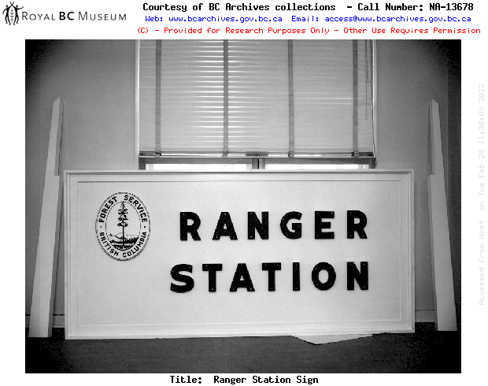

Slide 4
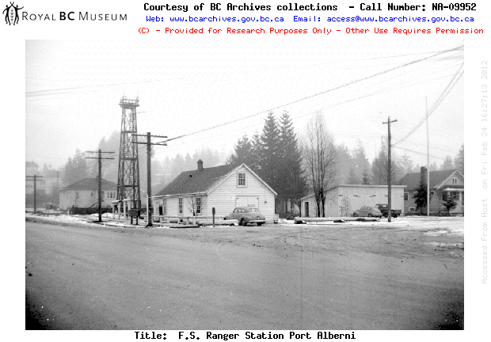
Notes:
1949

Slide 5
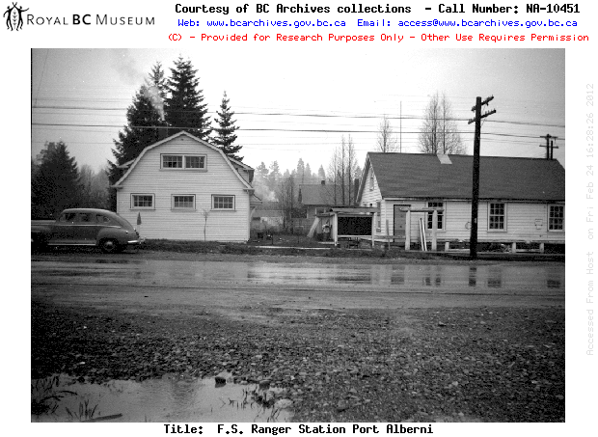
Notes:
1950

Slide 6
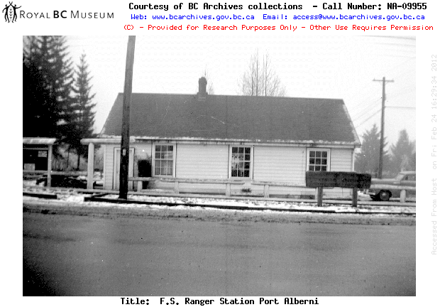
Notes:
1949

Slide 7
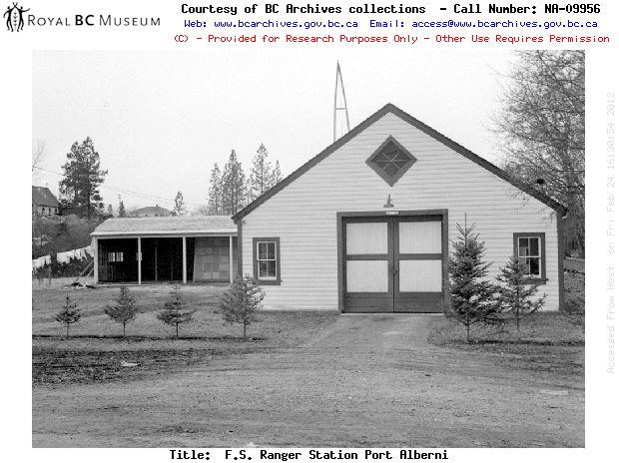
Notes:
1949

Slide 8
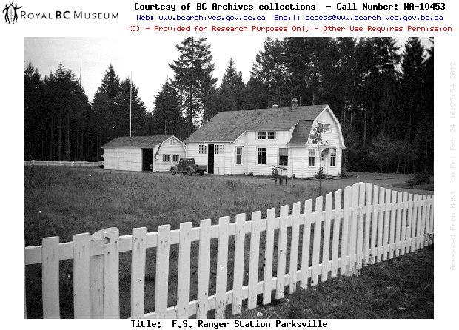

Slide 9
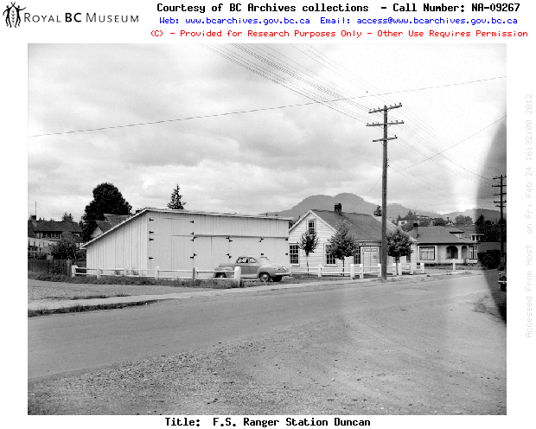

Slide 10
District Roads

Slide 11
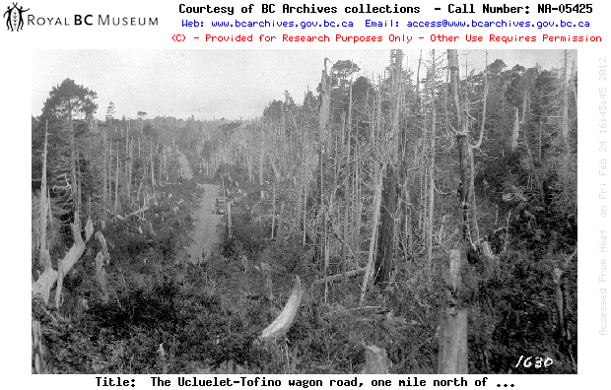
Notes:
1926

Slide 12
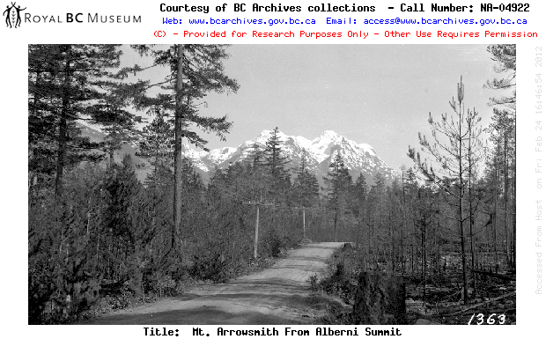
Notes:
1925

Slide 13
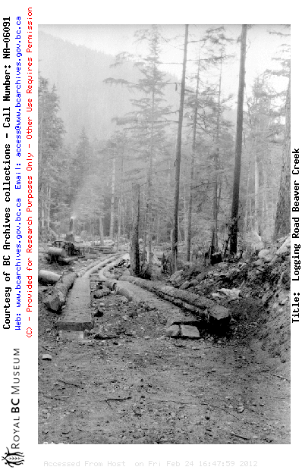

Slide 14
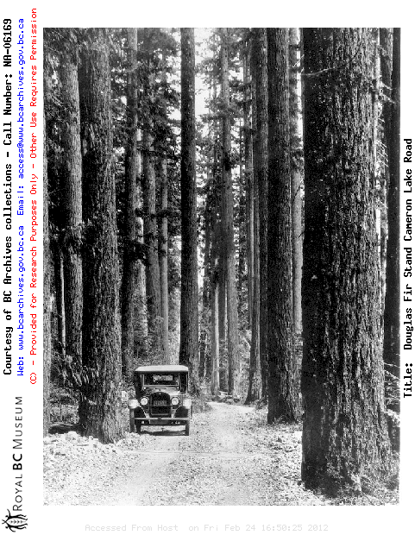
Notes:
Cathedral Grove 1931

Slide 15
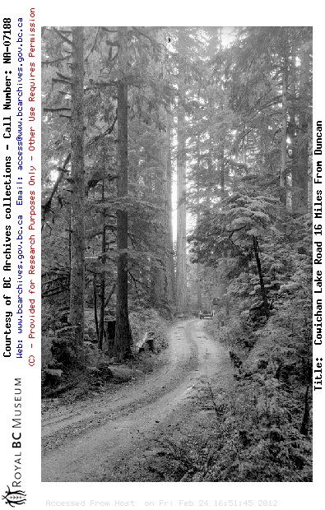

Slide 16
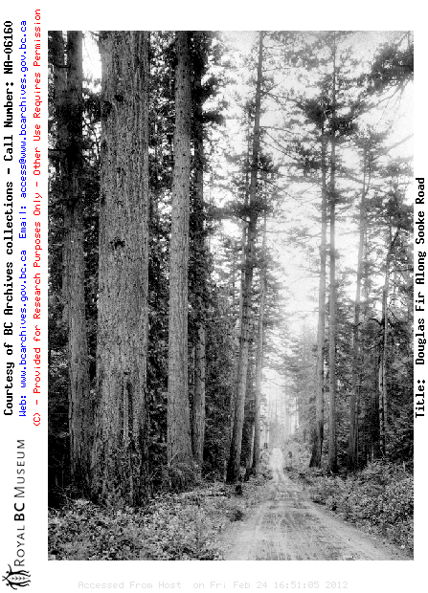
Notes:
1928

Slide 17
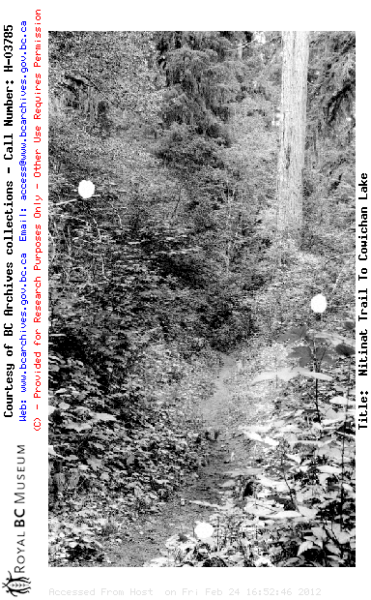
Notes:
Nitinat Trail 1914

Slide 18
Rangers et al.

Slide 19
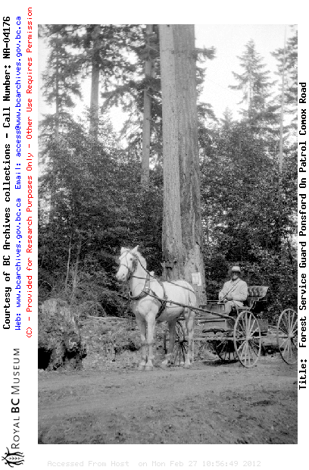

Slide 20
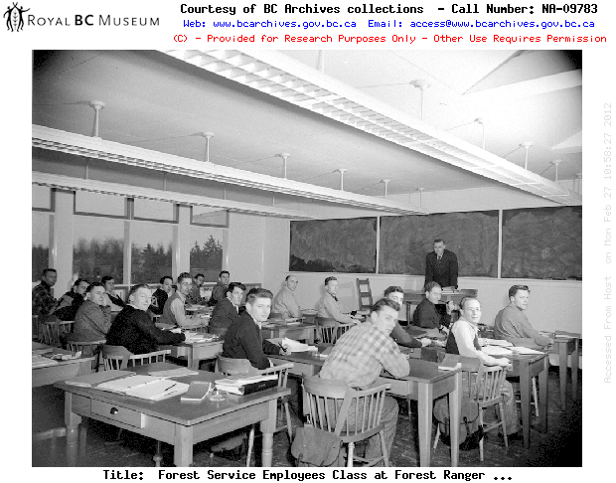
Notes:
1949

Slide 21
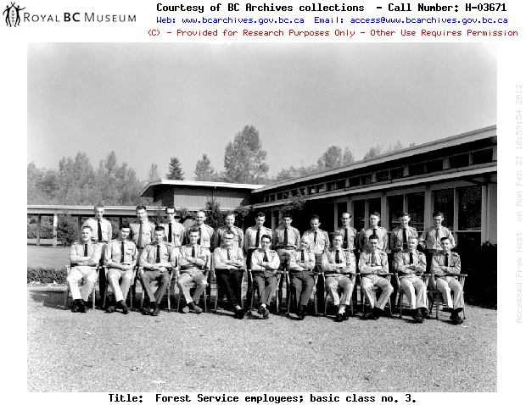

Slide 22
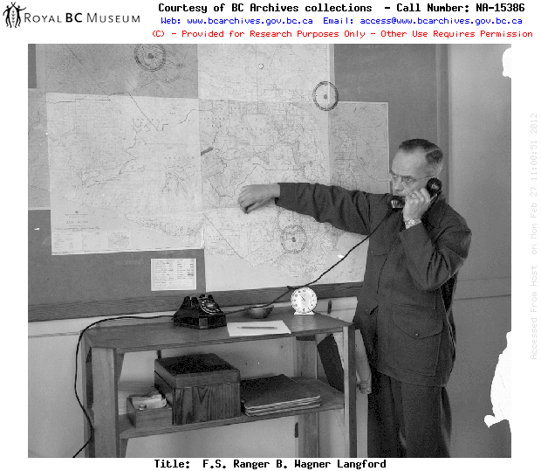

Slide 23
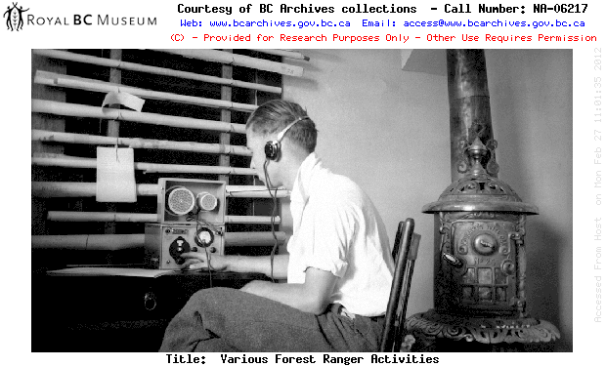

Slide 24
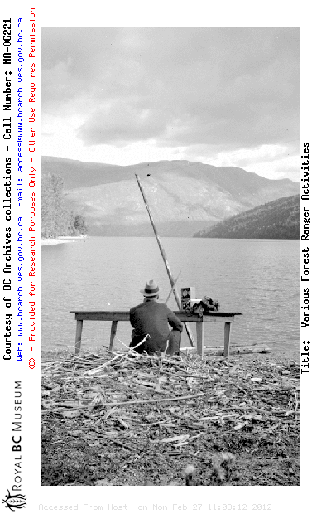

Slide 25
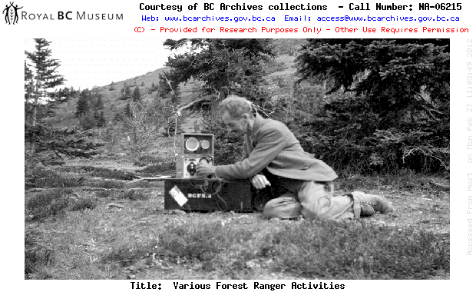

Slide 26
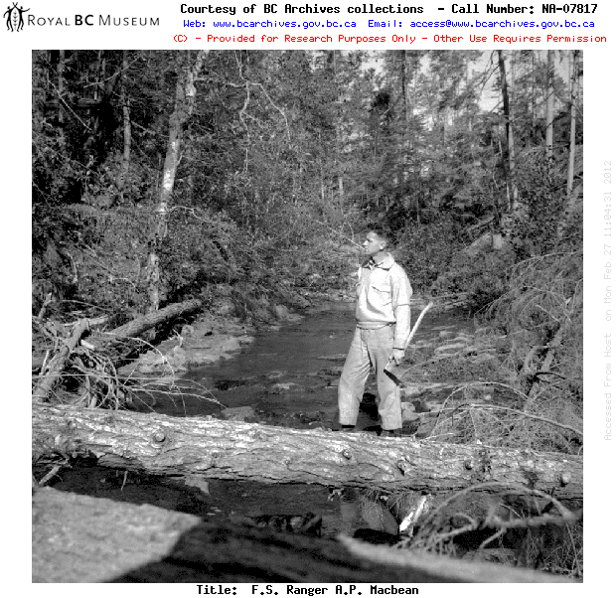

Slide 27
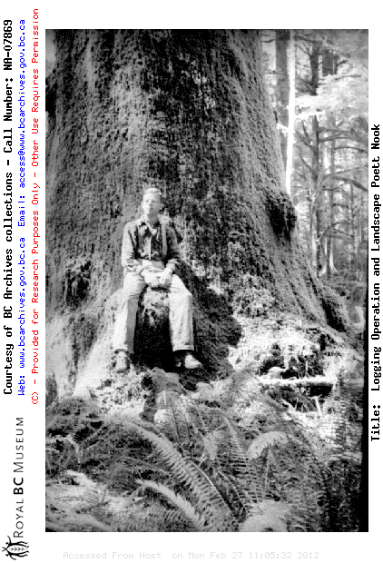
Notes:
Poett Nook 1943

Slide 28
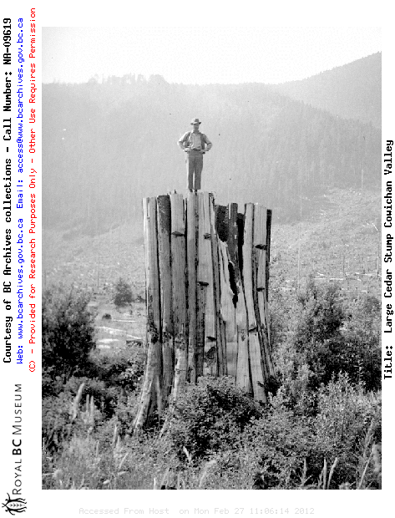

Slide 29
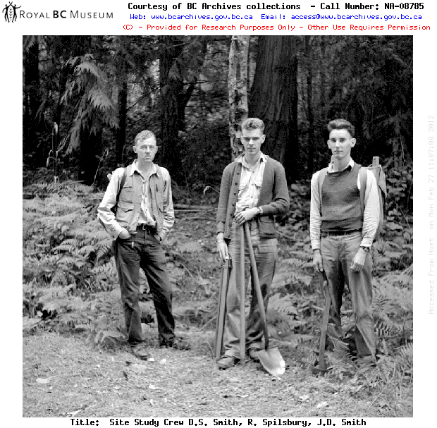
Notes:
1945

Slide 30
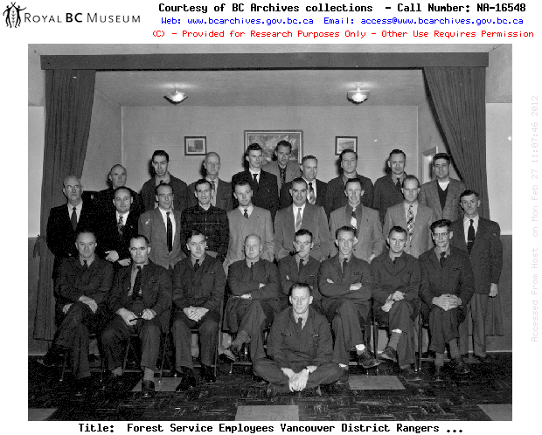
Notes:
1957

Slide 31
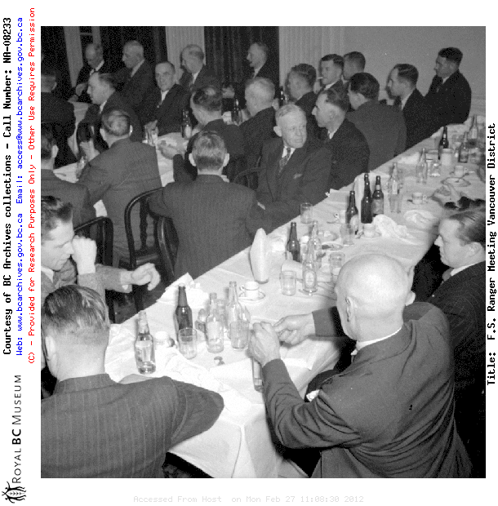
Notes:
1957

Slide 32
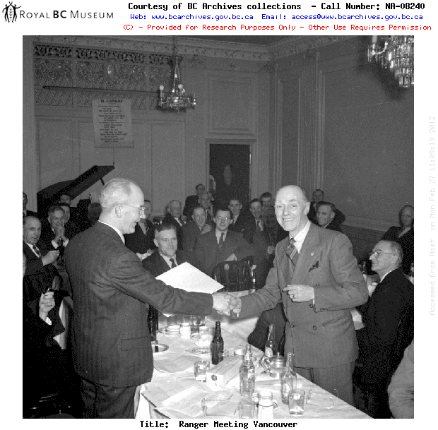
Notes:
1957

Slide 33
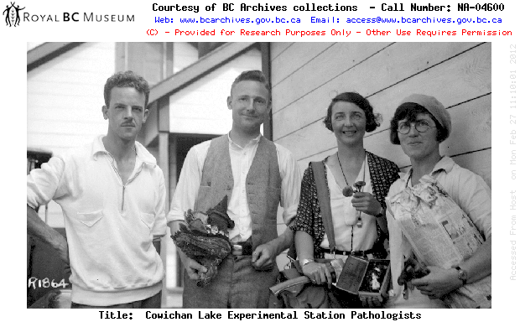
Notes:
1922

Slide 34
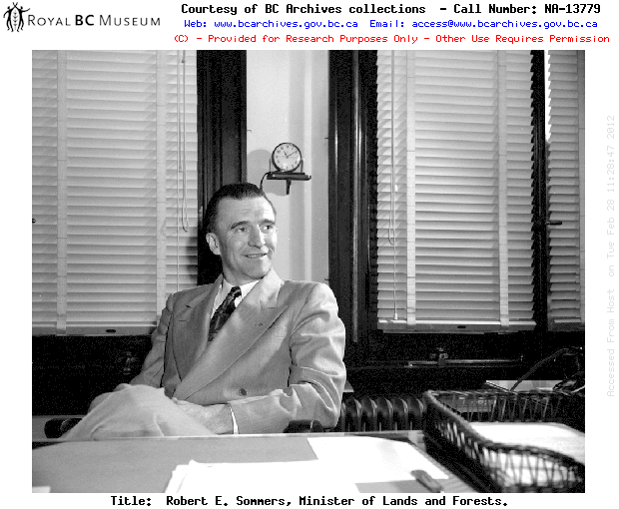
Notes:
1952

Slide 35
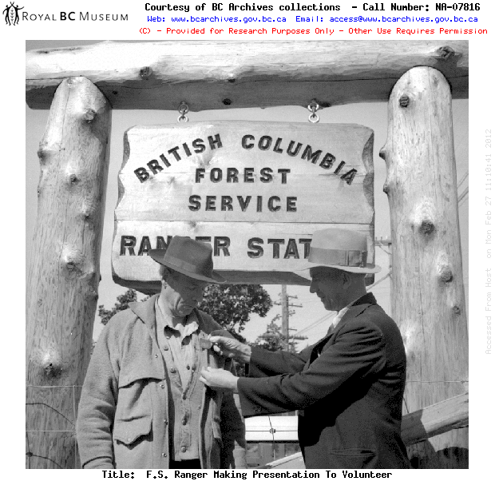

Slide 36
Forest Service Launches
.....not Boats

Slide 37
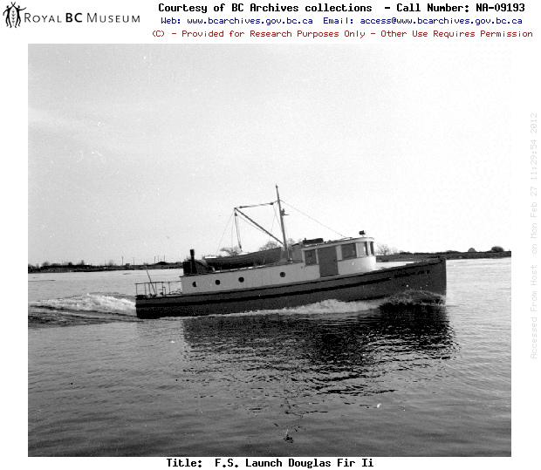

Slide 38
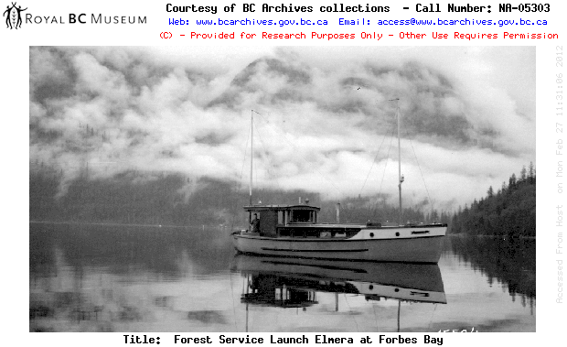

Slide 39
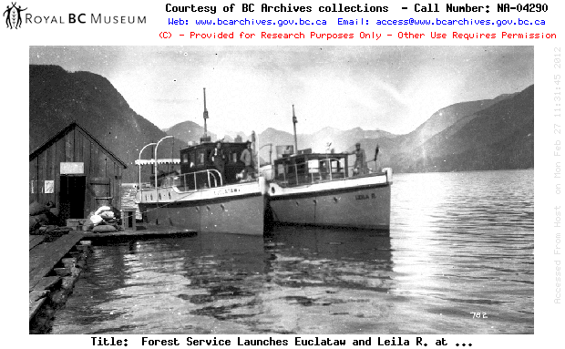

Slide 40
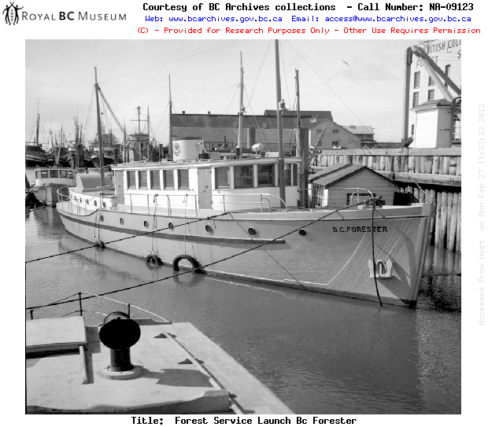

Slide 41
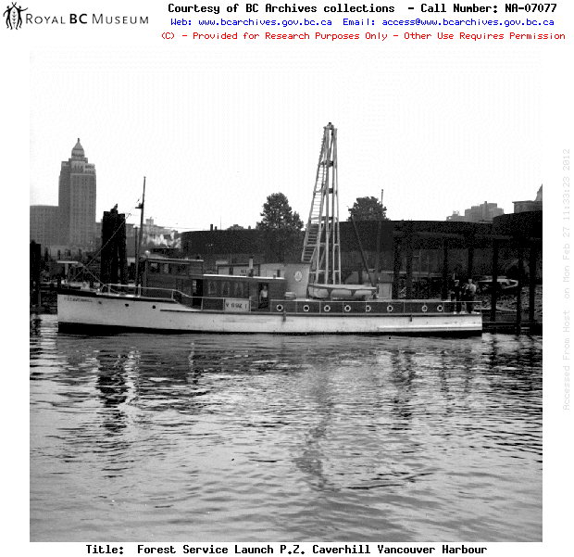
Notes:
1940

Slide 42
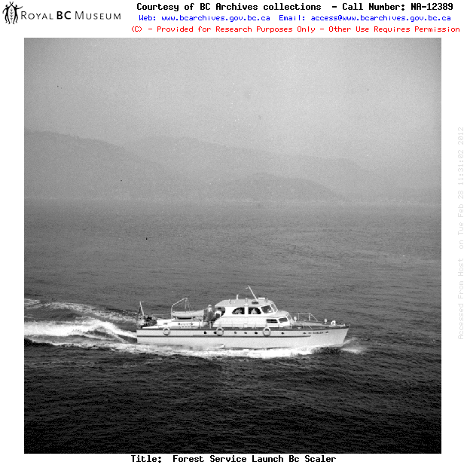

Slide 43
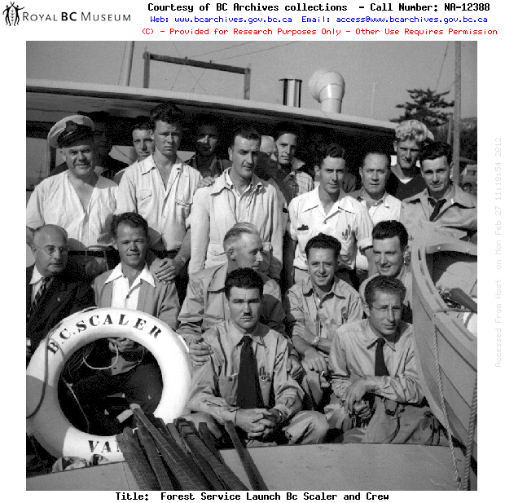

Slide 44
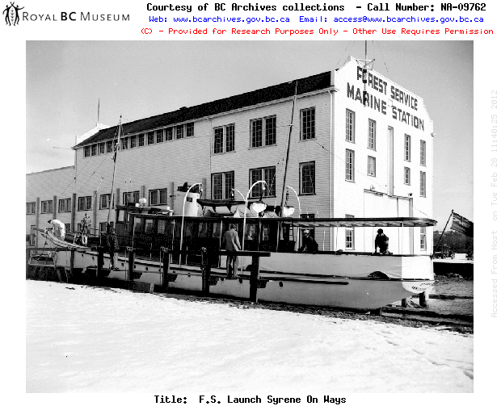

Slide 45
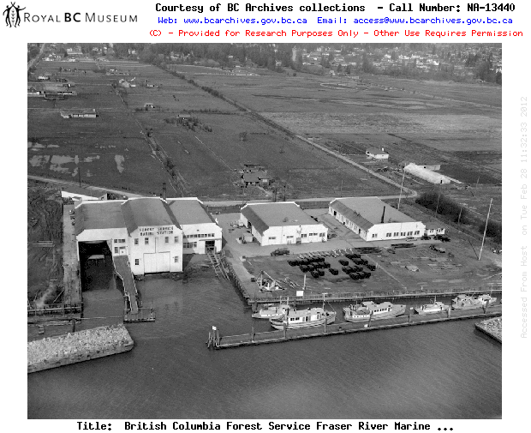
Notes:
1952

Slide 46
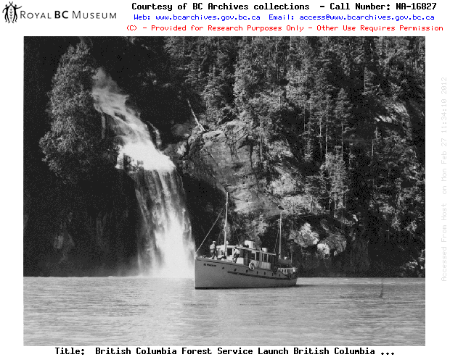

Slide 47
Fire Lookouts

Slide 48
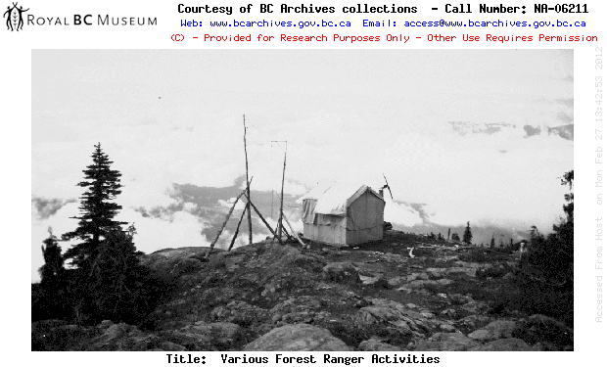
Notes:
Bainbridge Lookout 1937

Slide 49
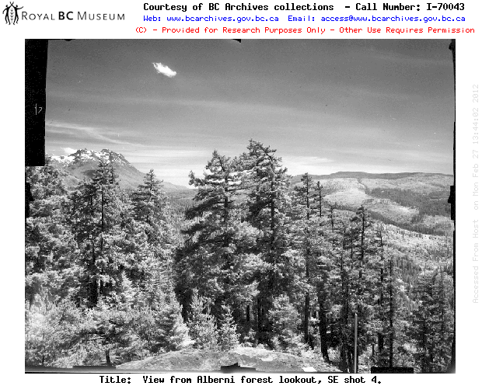
Notes:
1959

Slide 50
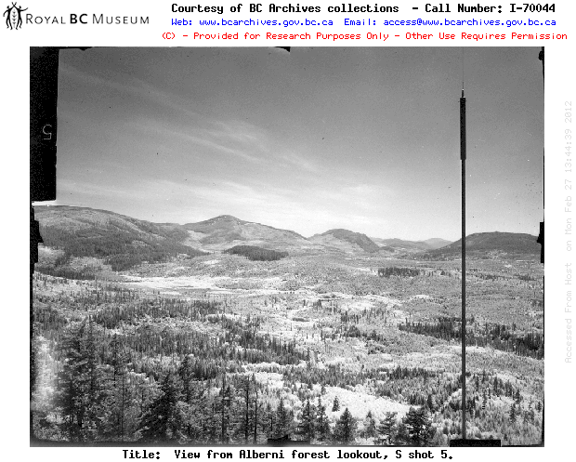
Notes:
1959

Slide 51
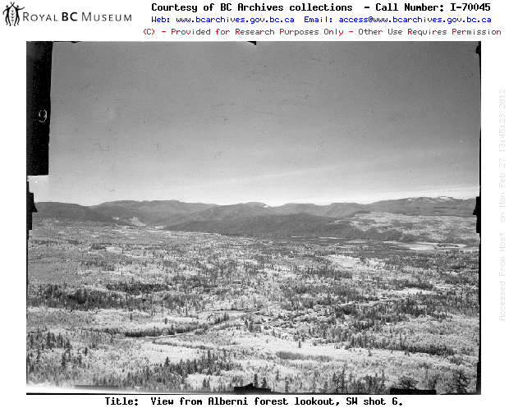
Notes:
1959

Slide 52
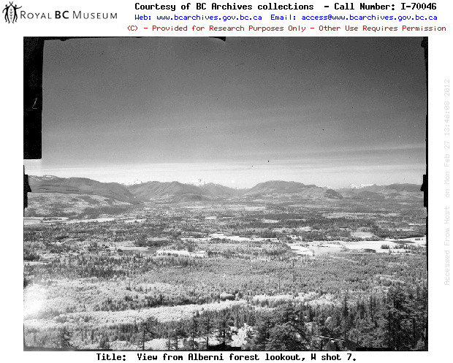
Notes:
1959

Slide 53
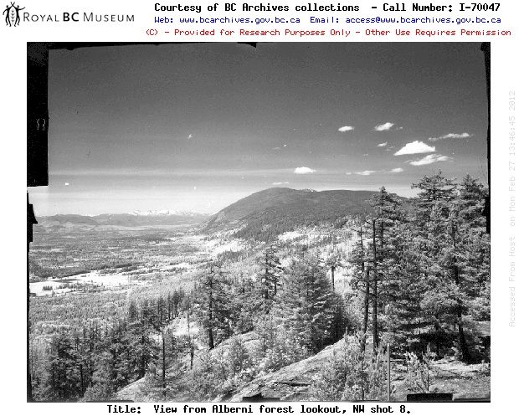
Notes:
1959

Slide 54
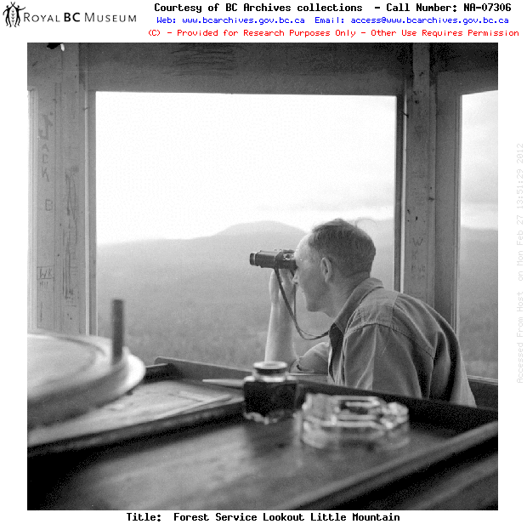
Notes:
1942

Slide 55
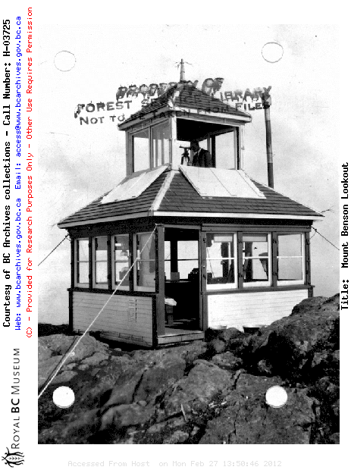
Notes:
Mt. Benson Lookout 1925

Slide 56
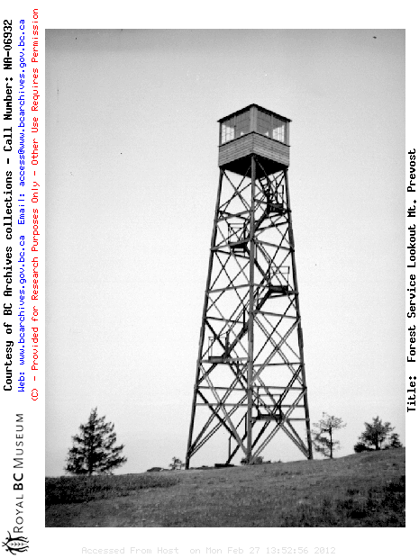
Notes:
Mt. Prevost Lookout

Slide 57


Slide 58

Notes:
Thetis Mountain Lookout

Slide 59

Notes:
1959

Slide 60


Slide 61
Firefighting

Slide 62

Notes:
1948

Slide 63


Slide 64


Slide 65

Notes:
1938

Slide 66

Notes:
1938

Slide 67


Slide 68

Notes:
1938 Campbell River

Slide 69

Notes:
1938 Evacuation of Campbell River

Slide 70

Notes:
1938

Slide 71

Notes:
1938

Slide 72
Logging

Slide 73


Slide 74


Slide 75

Notes:
Falling at Port Renfrew 1940

Slide 76


Slide 77

Notes:
1944

Slide 78


Slide 79

Notes:
1936

Slide 80

Notes:
1940

Slide 81


Slide 82

Notes:
Steam donkey at Nitinat Lake 1937

Slide 83

Notes:
1937

Slide 84

Notes:
1937

Slide 85

Notes:
A Frame at Sproat Lake 1948

Slide 86

Notes:
1963

Slide 87


Slide 88

Notes:
1938

Slide 89

Notes:
1943

Slide 90

Notes:
1938

Slide 91

Notes:
1934

Slide 92

Notes:
1943

Slide 93

Notes:
1943

Slide 94


Slide 95

Notes:
1943

Slide 96

Notes:
1944

Slide 97

Notes:
1951

Slide 98


Slide 99

Notes:
1937

Slide 100


Slide 101

Notes:
Where’s this?

Slide 102


Slide 103


Slide 104

Notes:
1928

Slide 105

Notes:
1940

Slide 106

Notes:
1952

Slide 107
Cowichan Lake
Experimental Station

Slide 108


Slide 109


Slide 110


Slide 111


Slide 112


Slide 113


Slide 114


Slide 115
Silviculture

Slide 116


Slide 117


Slide 118


Slide 119


Slide 120


Slide 121


Slide 122


Slide 123


